Slide 1
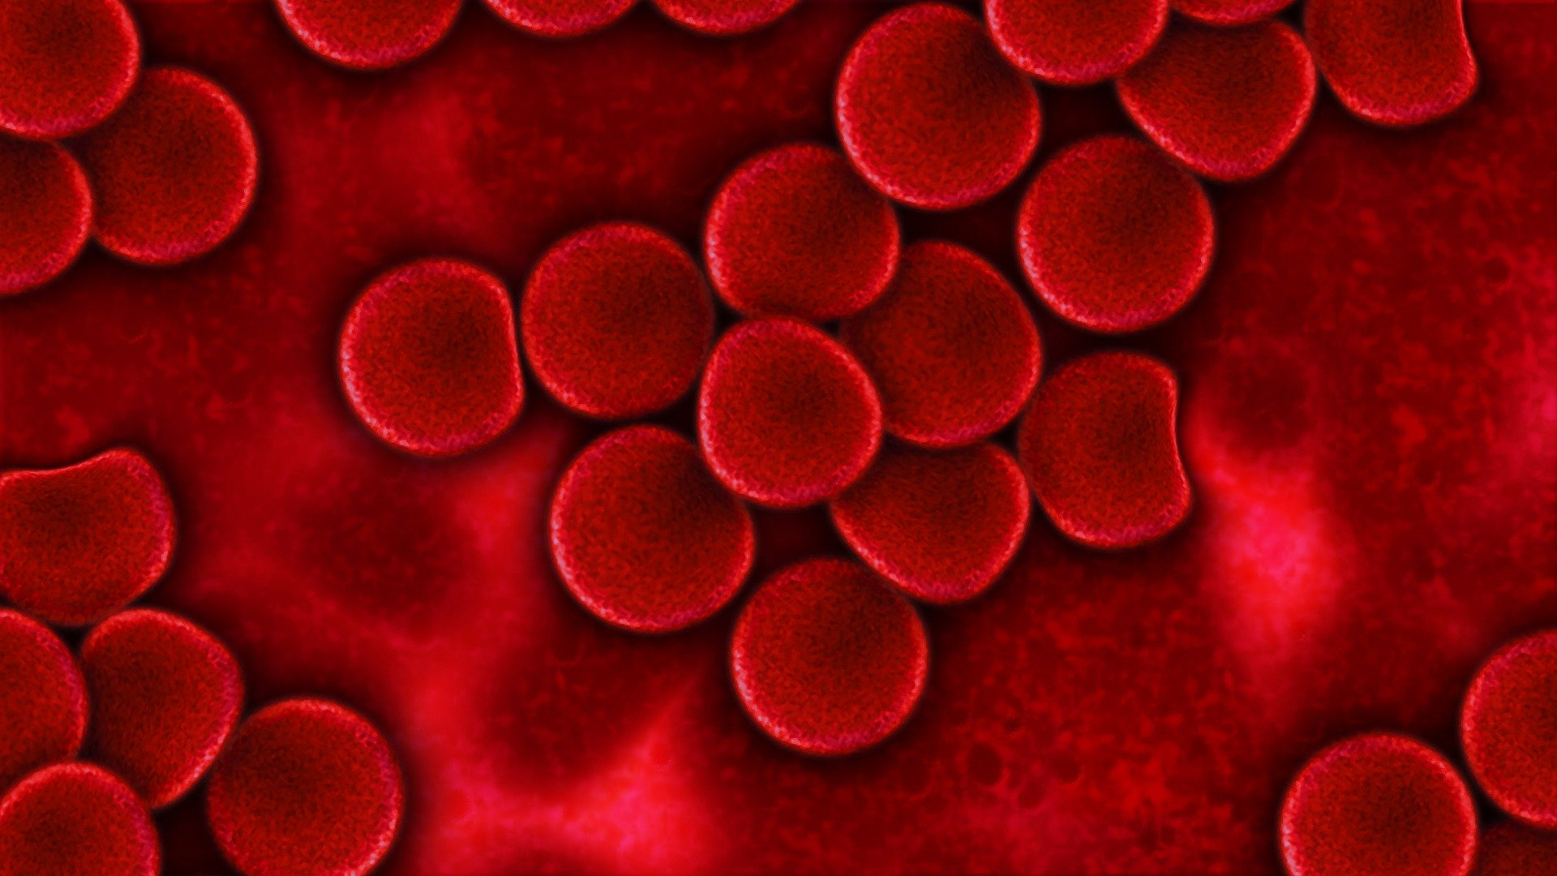
THE STRUCTURE AND FUNCTION OF THE HUMAN CIRCULATORY SYSTEM

Slide 2
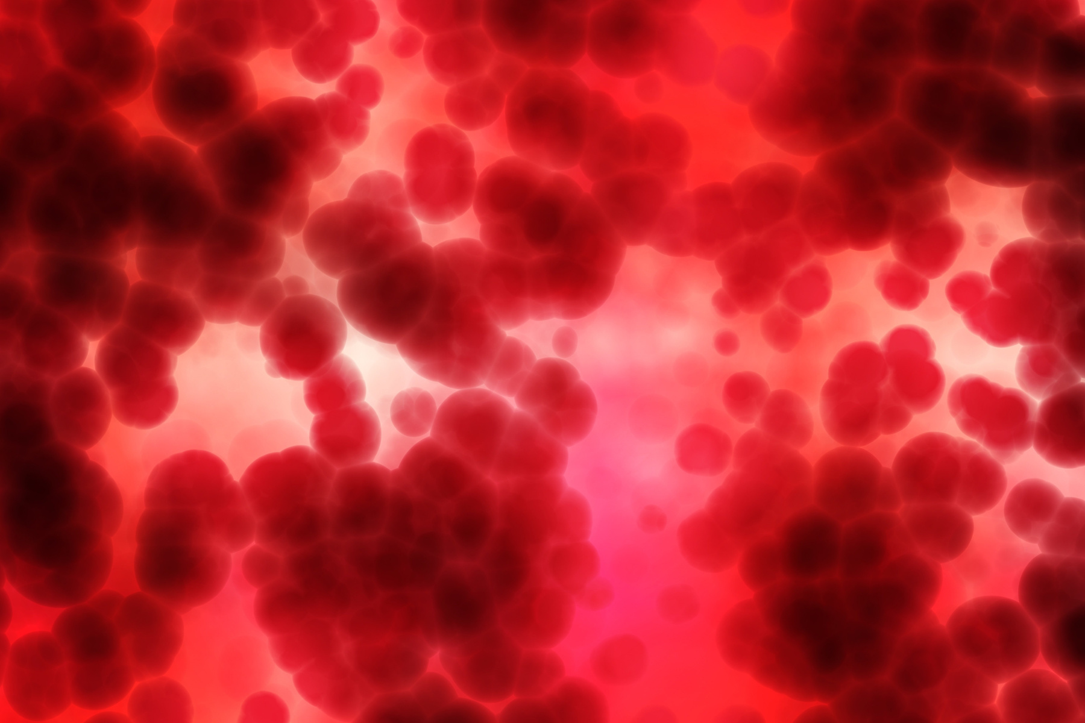
LESSON OBJECTIVES
Identify parts of the circulatory system.
Explain how structure supports function.
Understand gas exchange and nutrient flow.

Slide 3
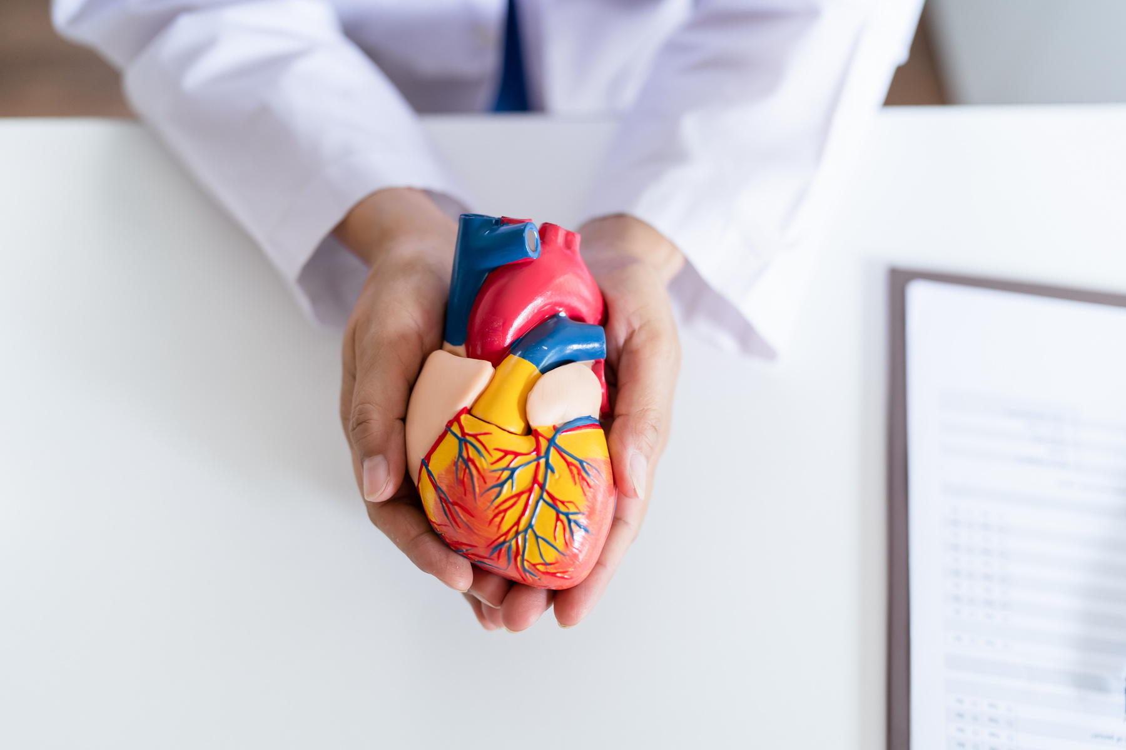
HEART STRUCTURE AND FUNCTION
The heart is a muscular organ with four chambers (two atria and two ventricles).
It pumps oxygenated blood from the lungs to the rest of the body. It then collects deoxygenated blood from the body and sends it back to the lungs to pick up more oxygen.
The left ventricle (side) of the heart has thicker muscle because it has to pump blood to the entire body.

Slide 4
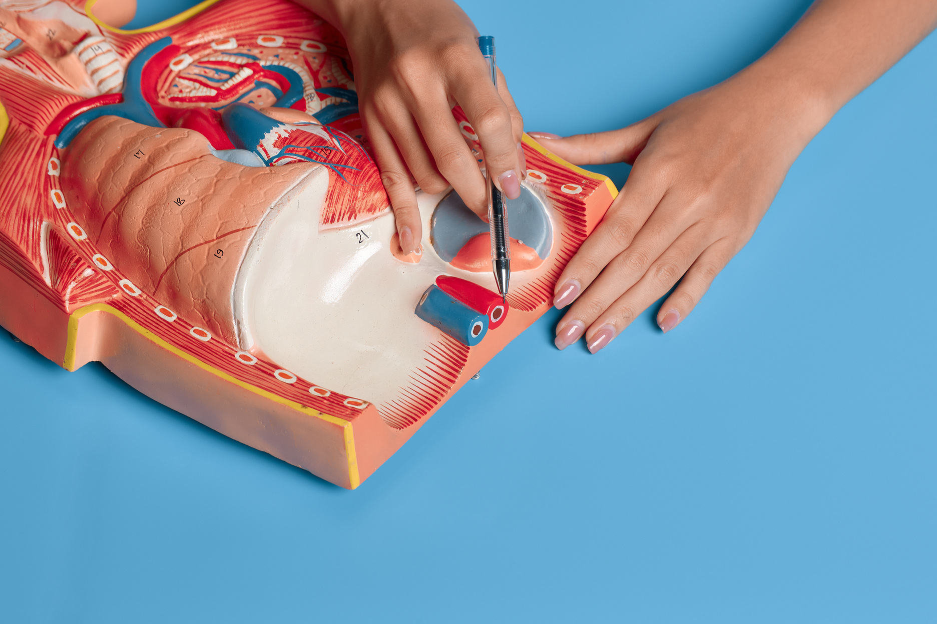
BLOOD VESSEL STRUCTURE AND PURPOSE
The arteries have thick walls and narrow lumen to handle high pressure.
The veins have thinner walls and a wider lumen for blood under lower pressure flowing back to the heart.
The veins have valves to prevent backflow.
The walls of the capillaries are one cell thick, allowing efficient gas exchange.

Slide 5
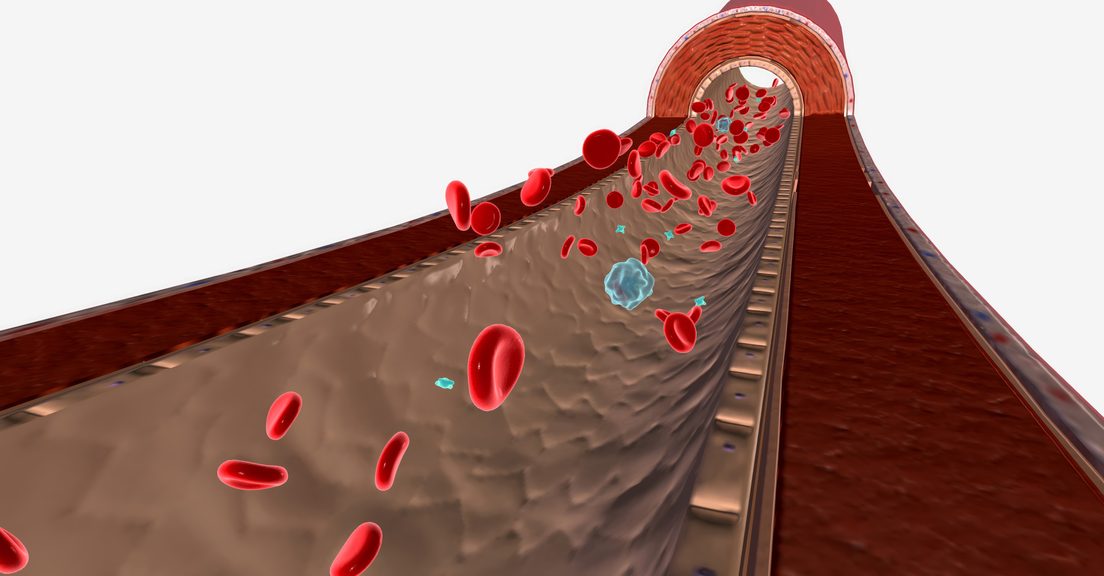
BLOOD CELLS
Red blood cells are disc-shaped for a large surface area, helping them carry more oxygen.
White blood cells have flexible shape to squeeze through vessel walls and reach infection sites.

Slide 6
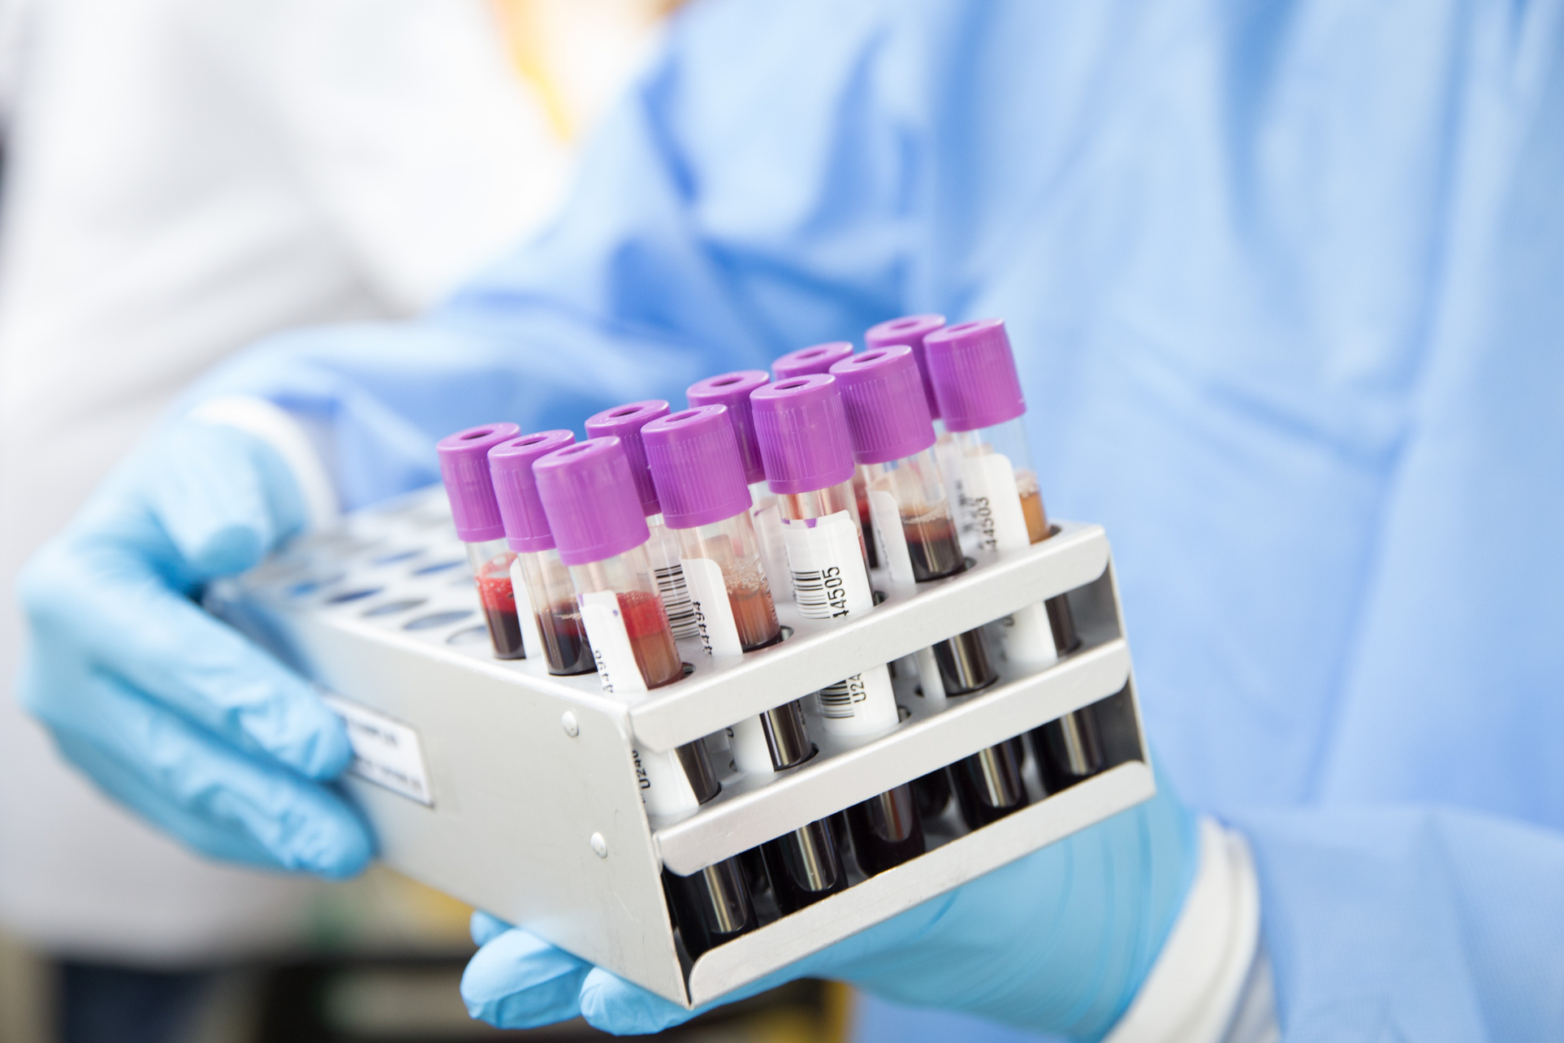
OTHER BLOOD COMPONENTS
Platelets are small and sticky to quickly form clots at injury sites.
Plasma is in a liquid form that allows it to flow easily, transporting nutrients and waste throughout the body.

